Slide 1
ALECK:THE LINGUIST BOT Learn IT GIRL PROJECT
Mentee:Purva Chiniya
Mentor: Anchal Hora

Slide 2
#1. Object detection from Image

Slide 3
Dataset :
Pascal VOC 2007 and Pascal VOC 2012 for training
PASCAL VOC 2007 trainval for validation
PASCAL VOC Test 2007 for evaluation
Model and Weights:
Training is done using VGG16 model as in the paper
ILSVRC weights has been used as in the original model.

Slide 4
SSD
Single Shot: this means that the tasks of object localization and classification are done in a single forward pass of the network
MultiBox: this is the name of a technique for bounding box regression developed by Szegedy et al.
Detector: The network is an object detector that also classifies those detected objects

Slide 5
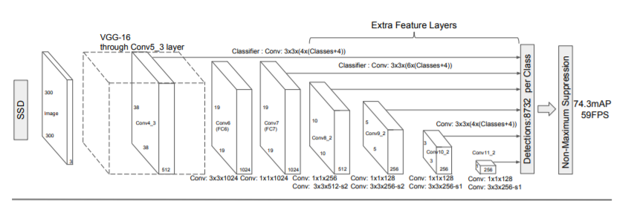
Architecture:

Slide 6
SSD’s architecture builds on the venerable VGG-16 architecture, but discards the fully connected layers.
The reason VGG-16 was used as the base network is because of its strong performance in high quality image classification tasks and its popularity for problems where transfer learning helps in improving results.
Instead of the original VGG fully connected layers, a set of auxiliary convolutional layers (from conv6 onwards) were added, thus enabling to extract features at multiple scales and progressively decrease the size of the input to each subsequent layer.

Slide 7
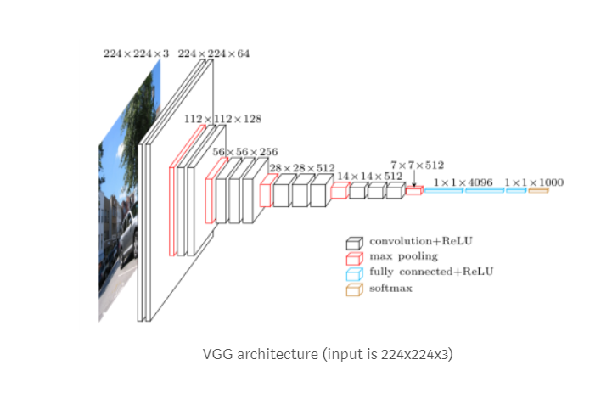
Model Architecture:

Slide 8
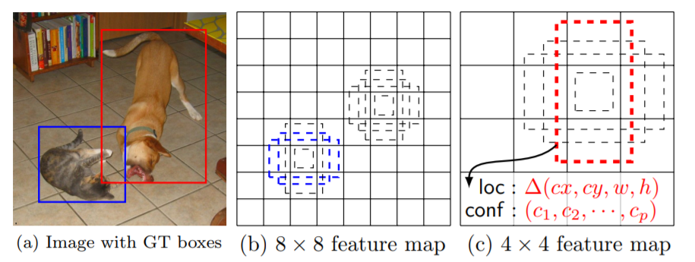
Every feature map cell is associated with a set of default bounding boxes of different dimensions and aspect ratios. These priors are manually (but carefully) chosen, whereas in MultiBox, they were chosen because their IoU with respect to the ground truth was over 0.5. This in theory should allow SSD to generalise for any type of input, without requiring a pre-training phase for prior generation. For instance, assuming we have configured 2 diagonally opposed points (x1, y1) and (x2, y2) for each b default bounding boxes per feature map cell , and c classes to classify, on a given feature map of size f = m * n, SSD would compute f * b * (4 + c) values for this feature map.

Slide 9
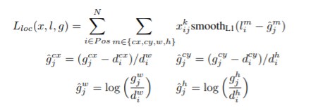
Location Loss:
SSD uses smooth L1-Norm to calculate the location loss. While not as precise as L2-Norm, it is still highly effective and gives SSD more room for manoeuvre as it does not try to be “pixel perfect” in its bounding box prediction (i.e. a difference of a few pixels would hardly be noticeable for many of us).

Slide 10
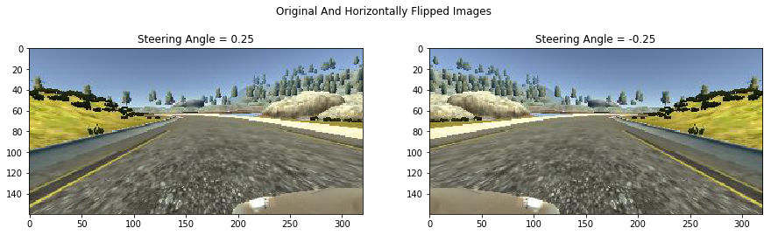
Data Augmentation
The authors of SSD stated that data augmentation, like in many other deep learning applications, has been crucial to teach the network to become more robust to various object sizes in the input. To this end, they generated additional training examples with patches of the original image at different IoU ratios (e.g. 0.1, 0.3, 0.5, etc.) and random patches as well. Moreover, each image is also randomly horizontally flipped with a probability of 0.5, thereby making sure potential objects appear on left and right with similar likelihood.

Slide 11
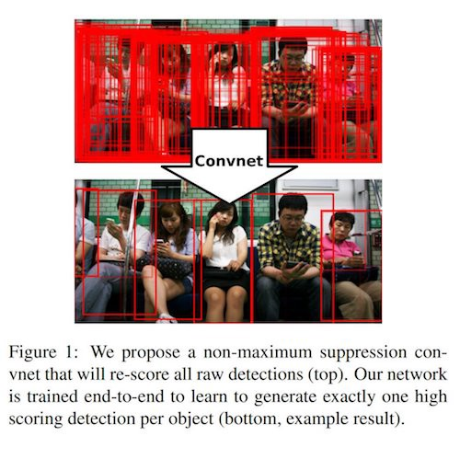
Non-Maximum Suppression (NMS)
Given the large number of boxes generated during a forward pass of SSD at inference time , it is essential to prune most of the bounding box by applying a technique known as non-maximum suppression: boxes with a confidence loss threshold less than ct (e.g. 0.01) and IoU less than lt (e.g. 0.45) are discarded, and only the top N predictions are kept. This ensures only the most likely predictions are retained by the network, while the more noisier ones are removed

Slide 12
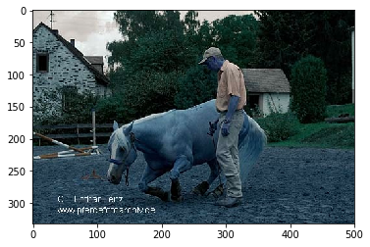
Input Image:

Slide 13
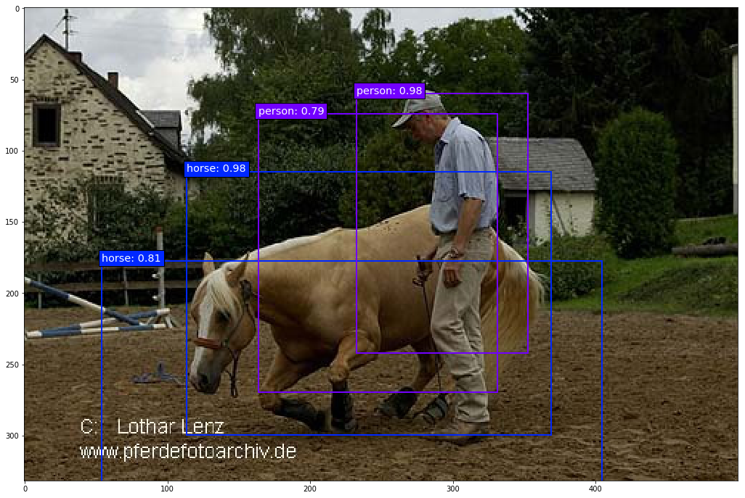
Output of the model:

Slide 14
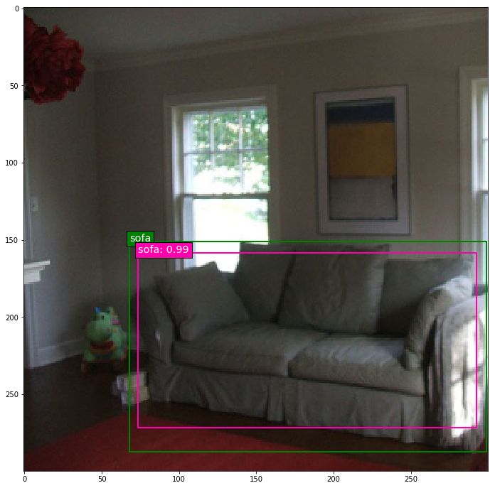
#Training Output

Slide 15
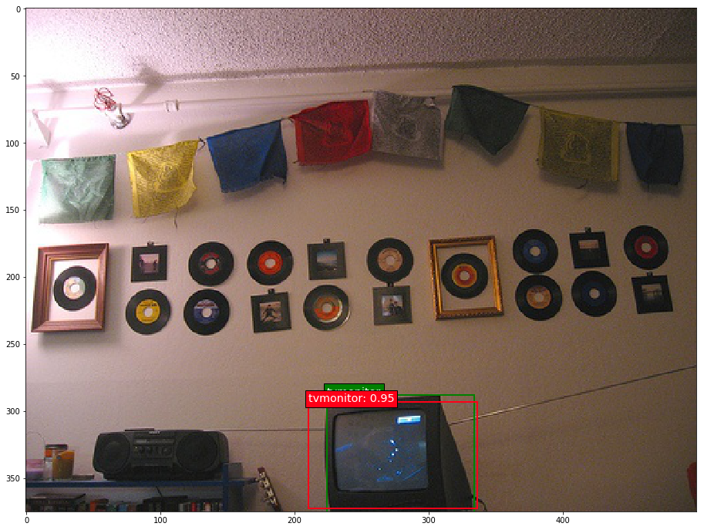

Slide 16
Predictions:
Output on voc test dataset is stored in repo.
Original documentation of challenge uses matab code on these files to compute accuracy and map score.

Slide 17
#2. Language Translation:Seq2Seq Model
Seq2Seq Model

Slide 18
DATASET:
WMT ENGLISH DATA
WMT FRENCH DATA

Slide 19
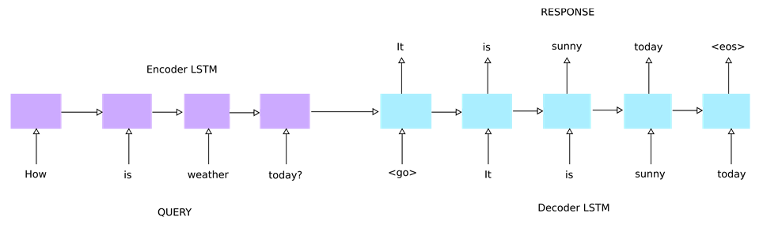
LSTM MODEL

Slide 20
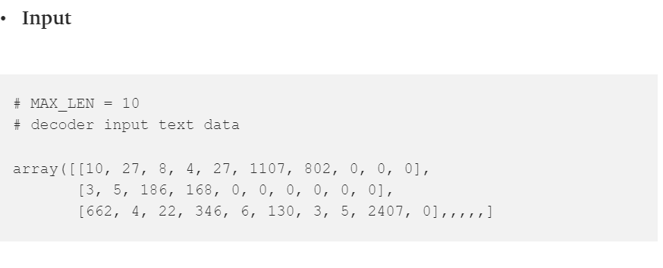
MODEL INPUT

Slide 21
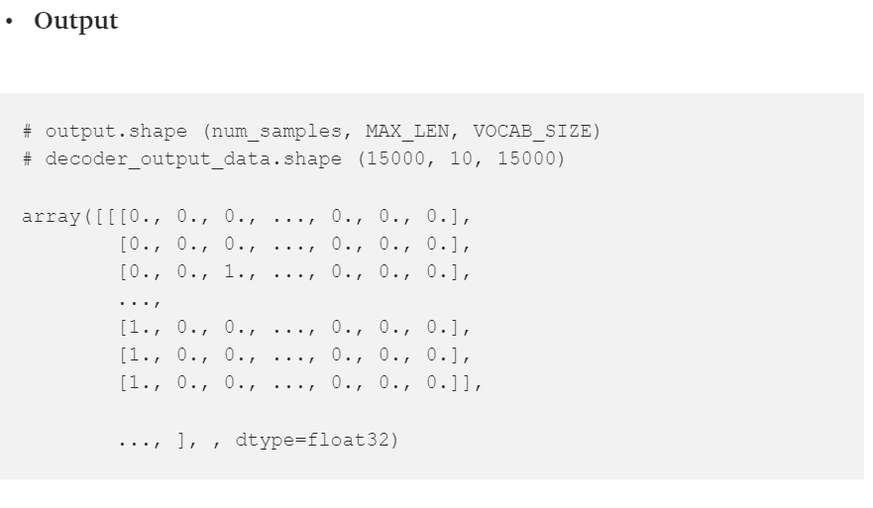
MODEL OUTPUT

Slide 22

#3. IMAGE TO TEXT TRANSLATION

Slide 23
DATASET
IAM PREPROCESSED DATA

Slide 24
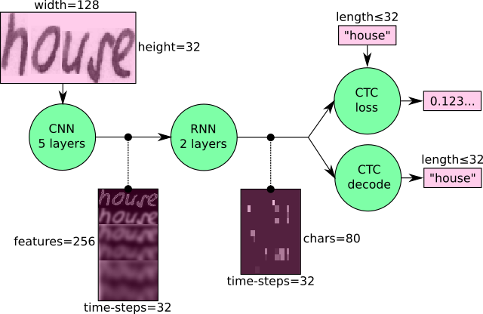
Model : CNN+RNN

Slide 25
CNN :
CNN: the input image is fed into the CNN layers. These layers are trained to extract relevant features from the image. Each layer consists of three operation. First, the convolution operation, which applies a filter kernel of size 5×5 in the first two layers and 3×3 in the last three layers to the input. Then, the non-linear RELU function is applied. Finally, a pooling layer summarizes image regions and outputs a downsized version of the input. While the image height is downsized by 2 in each layer, feature maps (channels) are added, so that the output feature map (or sequence) has a size of 32×256.

Slide 26
RNN:
RNN: the feature sequence contains 256 features per time-step, the RNN propagates relevant information through this sequence. The popular Long Short-Term Memory (LSTM) implementation of RNNs is used, as it is able to propagate information through longer distances and provides more robust training-characteristics than vanilla RNN. The RNN output sequence is mapped to a matrix of size 32×80. The IAM dataset consists of 79 different characters, further one additional character is needed for the CTC operation (CTC blank label), therefore there are 80 entries for each of the 32 time-steps.

Slide 27
LOSS
CTC: while training the NN, the CTC is given the RNN output matrix and the ground truth text and it computes the loss value. While inferring, the CTC is only given the matrix and it decodes it into the final text. Both the ground truth text and the recognized text can be at most 32 characters long.

Slide 28
CNN OUTPUT:
CNN output: Fig. shows the output of the CNN layers which is a sequence of length 32. Each entry contains 256 features. Of course, these features are further processed by the RNN layers, however, some features already show a high correlation with certain high-level properties of the input image: there are features which have a high correlation with characters (e.g. “e”), or with duplicate characters (e.g. “tt”), or with character-properties such as loops (as contained in handwritten “l”s or “e”s).

Slide 29
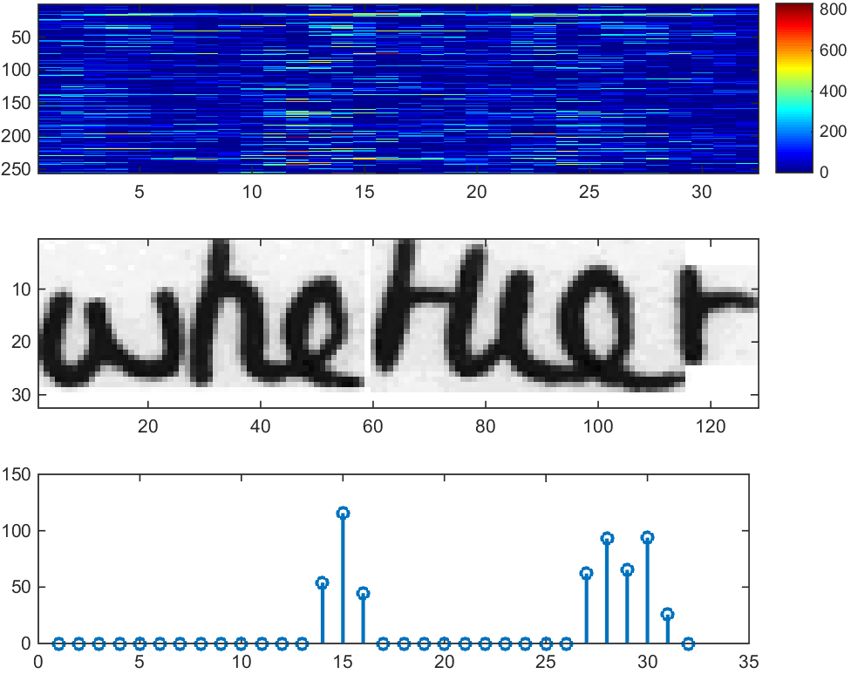

Slide 30
RNN OUTPUT
RNN output: Fig. shows a visualization of the RNN output matrix for an image containing the text “little”. The matrix shown in the top-most graph contains the scores for the characters including the CTC blank label as its last (80th) entry. The other matrix-entries, from top to bottom, correspond to the following characters: “ !”#&’()*+,-./0123456789:;?ABCDEFGHIJKLMNOPQRSTUVWXYZabcdefghijklmnopqrstuvwxyz”. It can be seen that most of the time, the characters are predicted exactly at the position they appear in the image (e.g. compare the position of the “i” in the image and in the graph). Only the last character “e” is not aligned. But this is OK, as the CTC operation is segmentation-free and does not care about absolute positions. From the bottom-most graph showing the scores for the characters “l”, “i”, “t”, “e” and the CTC blank label, the text can easily be decoded: we just take the most probable character from each time-step, this forms the so called best path, then we throw away repeated characters and finally all blanks: “l---ii--t-t--l-…-e” → “l---i--t-t--l-…-e” → “little”.

Slide 31
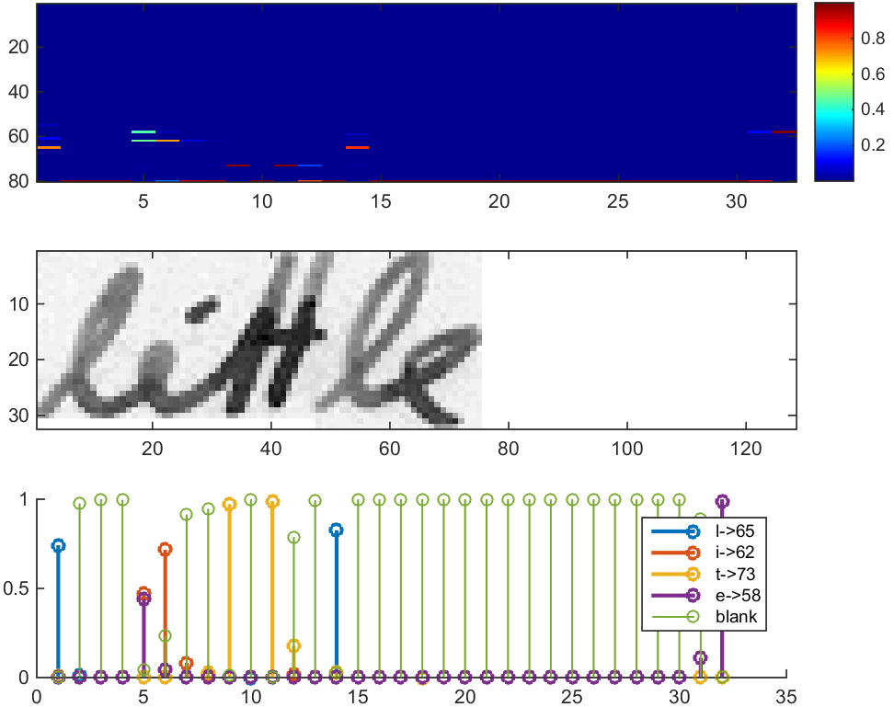

Slide 32
CTC
For loss calculation, we feed both the ground truth text and the matrix to the operation. The ground truth text is encoded as a sparse tensor. The length of the input sequences must be passed to both CTC operations.

Slide 33
#4.SPEECH TO SPEECH TRANSLATION
GOOGLE API OFFERS THIS FEATURE

Slide 34
#5. TEXT SUMMARIZATION
SIMPLE NLP MODEL IS USED FOR TEXT SUMMARIZATION
CODE IS UPLOAEDED IN THE REPOSITORY

Slide 35
THANK YOU
I WOULD LIKT TO THANK THE LEARN IT COMMUNITY TO GIVE ME THIS OPPORTUNITY TO LEARN AND PRESENT MY WORK VIA THIS PLATFORM.

